Slide 1

D.K.T.E. Society’s Textile and Engineering Institute, Ichalkaranji
“Snippet Visualization System” Presented by
Name Roll.no
Saloni P. Bamane 17UIT11003XX
Prajakta K. Bugade 17UIT11006XX
Aditi R. Wankhede 17UIT71017XX
Kaushik S. Talange 19UIT653XX
Harshal S. Shelar 16UIT52050XX
Sohel R. Zari 16UIT12058XX
Under the Guidance of:
Prof. S. C. Sagare

Slide 2
SR.NO | POINTS
1 | Introduction
2 | Need of the work
3 | Objectives
4 | Problem Statement
5 | Software requirement specification
6 | Design 1) System Architecture 2) Modules 3) Data flow Diagram 4) Algorithm
7 | Implementation
8 | System Requirement
9 | Results
10 | Conclusion
11 | References

Slide 3
1.Introduction:
Many of the internet users search for some query and in result they get ranked list of URL.
User could possibly get some disappointment with this related search.
Hence, we are developing a system that is focusing on retrieving search results in thumbnail form.
User can have interaction with more results in single view.
It affords easy navigation and is straightforward to interpret with user.

Slide 4
2. Abstract
Internet users are very familiar with the results of a search query displayed as a ranked list of snippets. Each textual snippet shows a content summary of the referred document (or web page) and a link to it. This display has many advantages, e.g., it affords easy navigation and is straightforward to interpret. Nonetheless, any user of search engines could possibly report some experience of disappointment with this metaphor. Indeed, it has limitations in particular situations, as it fails to provide an overview of the document collection retrieved. Moreover, depending on the nature of the query - e.g., it may be too general, or ambiguous, or ill expressed – the desired information may be poorly ranked, or results may contemplate varied topics. Several search tasks would be easier if users were shown an overview of the returned documents, organized so as to reflect how related they are, content-wise.

Slide 5
3. Need Of Work With Motivating Example
The standard approach of displaying query results as a linear list of snippets is quite effective for most tasks performed by users of search engines. However, when users carry out an exploratory search on a broad topic or subject, linear lists are not so helpful, demanding additional effort towards gathering and mentally organizing the relevant information. The visualization technique introduced in this article, this project, has been designed to assist users in these exploratory scenarios. As such, it is not intended as a substitute for lists of snippets, but rather as an additional resource to improve user experience in specific situations. Therefore, the proposed visualization system aims at helping users to gain a more comprehensive view of the query results, highlighting related documents and web pages while still retaining, as much as possible, the good properties of the conventional list-based paradigm, namely, the rank information and the summary content provided by the snippets.

Slide 6
4.Objectives:
To perform pre processing of collected data.
To perform similarity identification and ranking the snippets using k means algorithm.
To perform optimization of the snippets for visualization purpose.
To analyze the performance of proposed system via experimental evaluation of results.

Slide 7
5.Problem Statement:
To develop visualization based technique for web search result based on the textual snippets.

Slide 8
6. Software requirement specification
The introduction of the Software Requirements Specification (SRS) provides an overview of the entire SRS with purpose and scope.
The purpose of this SRS document is to provide a detailed overview of our software product, its parameters and goals.
This document describes the project's target and its user interface, hardware and software requirements.
It defines how users see the product and its functionality.
Snippet visualization system focus on optimized results of web search engine, for making it easy to navigate and more user friendly.
The scope of this project is beyond the expectation,any user on worldwide can use it.

Slide 9
7. Scope And Limitation
This project requires a very simple pre-processing step, but some tricky issues remain. For example, setting appropriate values for Luhn’s lower and upper cuts in scenarios where little information is available, as it is the case here, is not straightforward and deserves further investigation. In our examples we typically employed a lower cut of three and no upper cut and removed the query terms from the vector representation. Finally, clustering in visual space will produce good results as long as the projection technique does a good job of preserving the relevant neighbourhood. Our choice of the LSP method is justified by its being known to perform quite well in terms of neighbourhood preservation, which is confirmed by the results.

Slide 10
8.Design
8.1 System Architecture
Fig 1-Snippet visualization system

Slide 11
8.2 Modules
1. Collecting information:
It is the first step where system will collect data from custom search engine and store it into database for further processing. Data is stored in the form of text, url and description displayed on the each web pages.
2. Pre-processing:
It is the second step where each entry returned from a textual query is processed and its term frequency vector extracted. Only the summary texts are processed rather than the full content of the referred documents or webpages, which renders the visualization algorithm fast.
3. Similarity Identification:
Multidimensional projection techniques may be employed to generate visualizations that favor the perception of groups of similar documents. Such methods typically represent documents as points in a two-dimensional visual space, where neighboring points correspond to documents with similar content. However, points onlyconvey information on neighborhood relations.

Slide 12
4. Ranking:
Snippet collected in similarity are then ranked in this module using following algorithm.
• Text based ranking algorithm.
• Weighted page ranking algorithm.
5 .Optimization:
This module Optimizes theplacement of the snippets so as to avoid overlapping while preserving data neighborhoods as computed by the projection.

Slide 13
8.3 Algorithm
Algorithms:K-means++
k-means++ clustering aims to find the set of k clusters such that every data point is assigned to the closest center.
Let X = {x1,x2,x3,……..,xn} be the set of data points and V = {v1,v2,…….,vc} be the set of centers.
1) Randomly select ‘c’ cluster centers.
2) Calculate the distance between each data point and cluster centers.
3) Assign the data point to the cluster center whose distance from the cluster center is minimum of all the cluster centers.
4) Recalculate the new cluster center using:
where, ‘ci’ represents the number of data points in ith cluster.
5) Recalculate the distance between each data point and new obtained cluster centers.
6) If no data point was reassigned then stop, otherwise repeat from step (3).

Slide 14
8.4 Data flow Diagram
Fig 2-DFD-0 for snippet visualization system

Slide 15
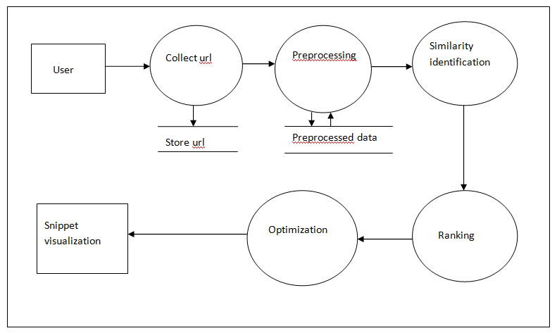
Fig 3-DFD-1 for snippt visualization system

Slide 16
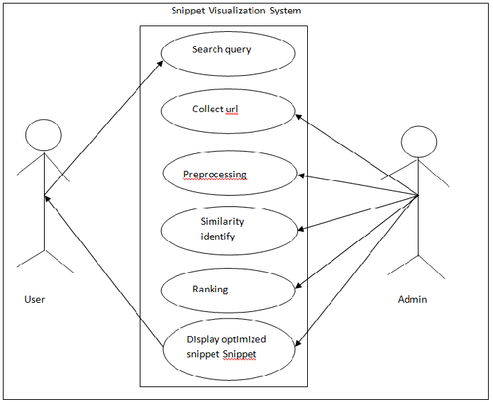
8.5 Use case diagram
Fig 6-Use Case Diagram

Slide 17
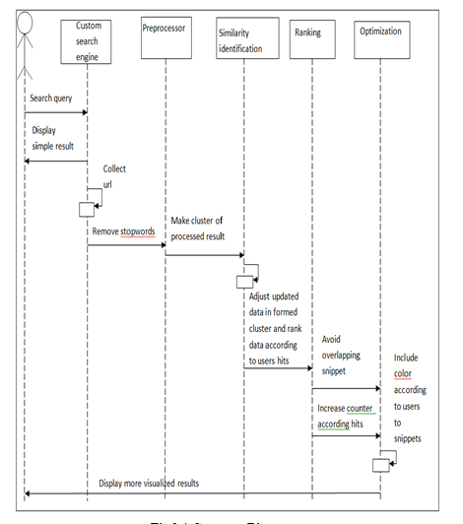
Sequence Diagram

Slide 18
9. Implementation
Once the design is approved technical implementation begins. This often the shortest phase because research and design have been done in advance.
For implementation we have used different web technology ie., php, javascript, ajax and open source database i.e., MySQl

Slide 19
10. Technology Used
1.PHP:
PHP (recursive acronym for php: Hypertext Preprocessor) is a widely-used open source general-purpose scripting language that is especially suited for web development and can be embedded into HTML.PHP is a widely-used, open source scripting language
PHP scripts are executed on the server.PHP files can contain text, HTML, CSS, JavaScript, and PHP code PHP code are executed on the server, and the result is returned to the browser as plain HTML.PHP files have extension ".php"

Slide 20
2.JavaScript:
JavaScript is a lightweight, interpreted programming language. It is designed for creating network-centric applications. JavaScript is very easy to implement because it is integrated with HTML. It is open and cross-platform.
JavaScript is most commonly used as a client side scripting language. When a user requests an HTML page with JavaScript in it, the script is sent to the browser and it's up to the browser to do something with it.

Slide 21
3.AJAX:
AJAX stands for Asynchronous JavaScript and XML. AJAX is a new technique for creating better, faster, and more interactive web applications with the help of XML, HTML, CSS, and Java Script. Ajax uses XHTML for content, CSS for presentation, along with Document Object Model and JavaScript for dynamic content display.

Slide 22
11. System Requirement
Software Requirements :
Language used : php5.x, javascript, AJAX
Server : XAMPP
Database : phpMyAdmin
Hardware Requirements :
Processor : 800MHz Intel Pentium III or equivalent
RAM : 2 GB
Disk space : 750 MB of free disk space
Internet connectivity

Slide 23
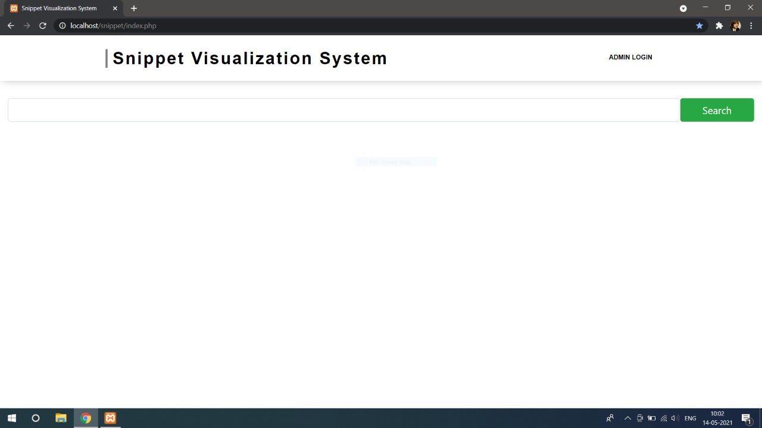

Slide 24
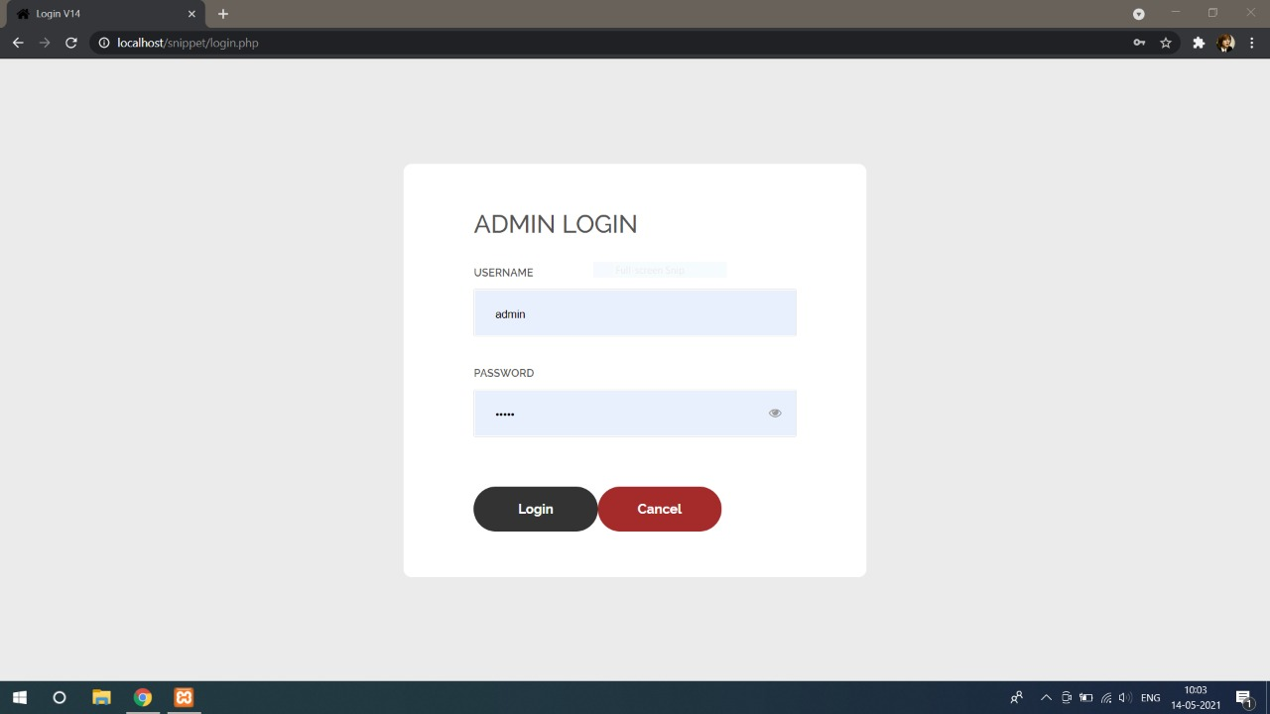

Slide 25
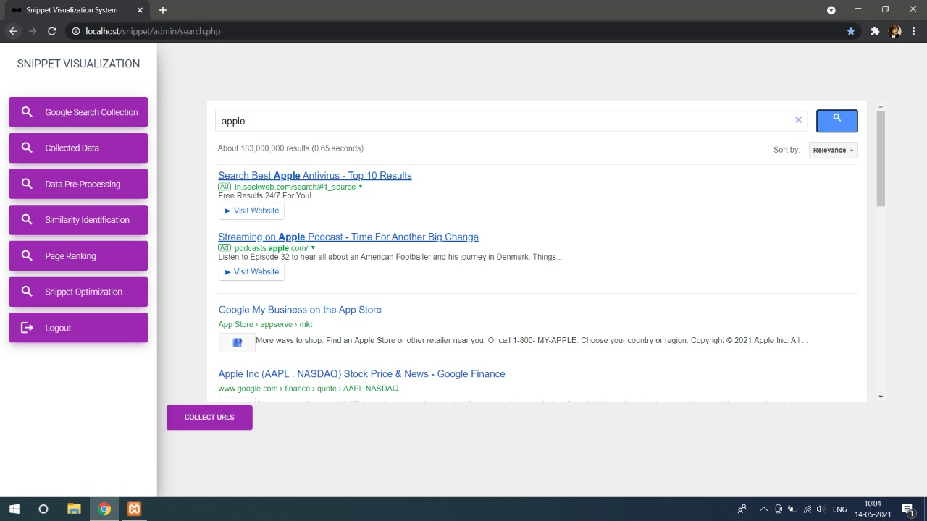

Slide 26
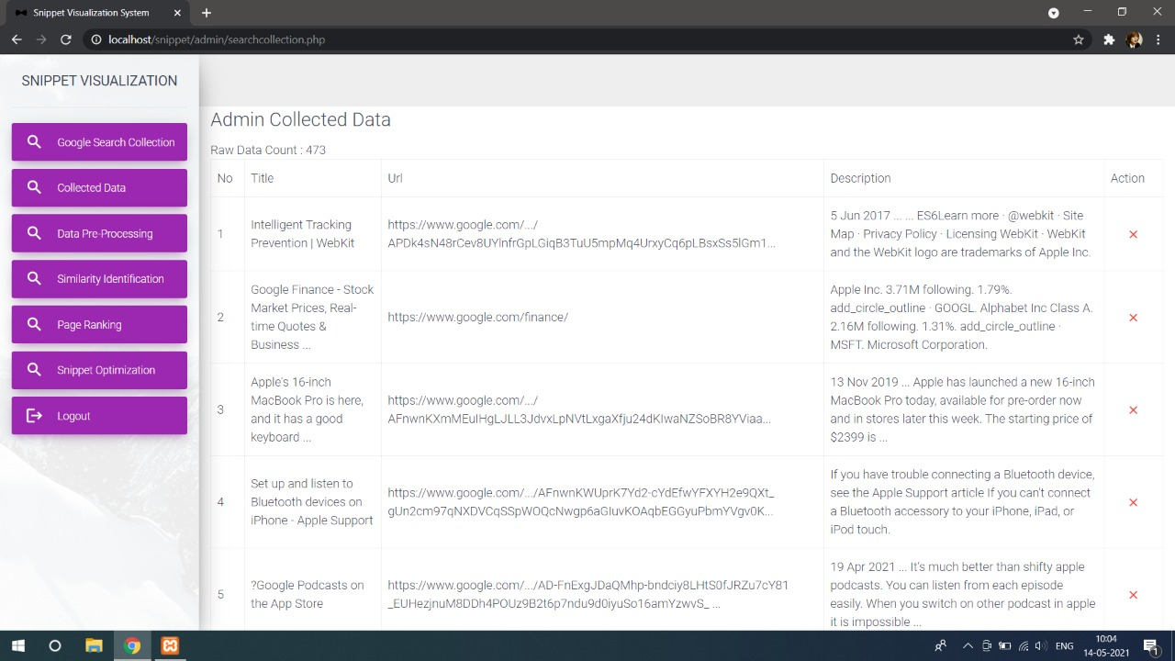

Slide 27
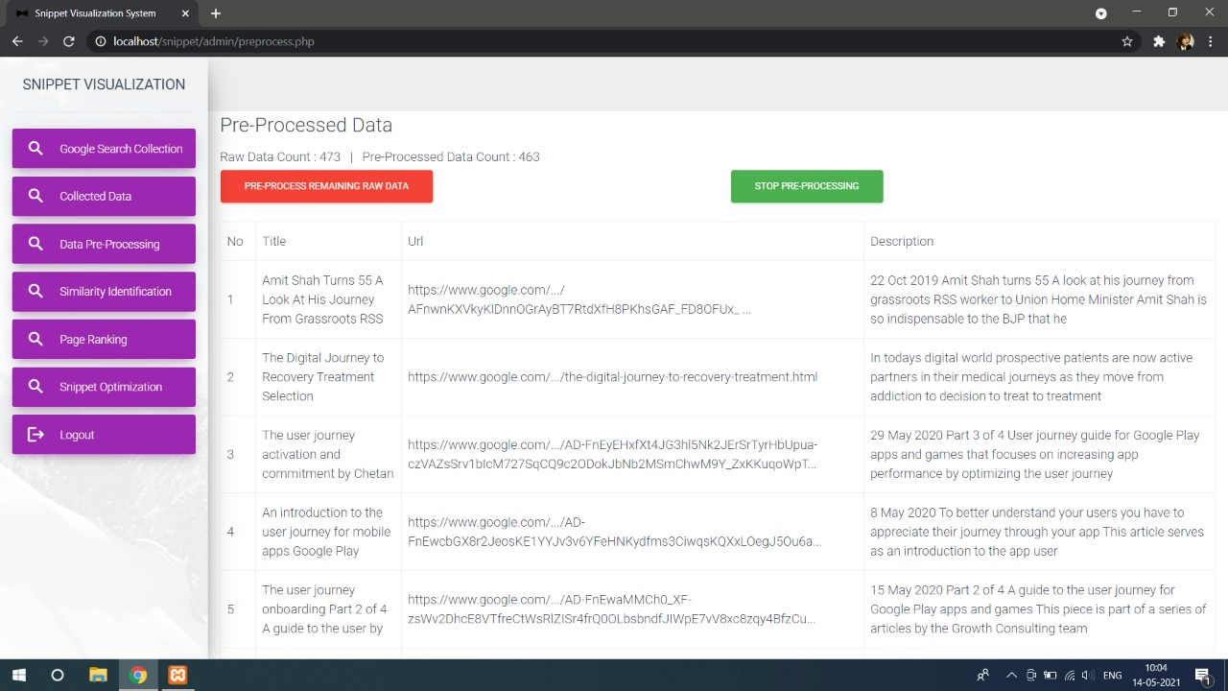

Slide 28
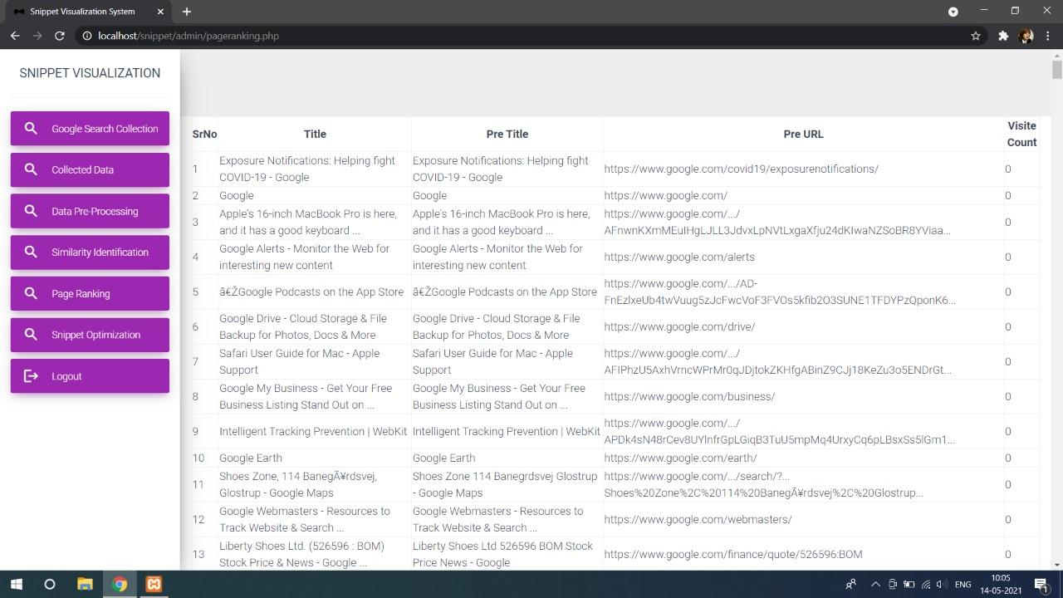

Slide 29
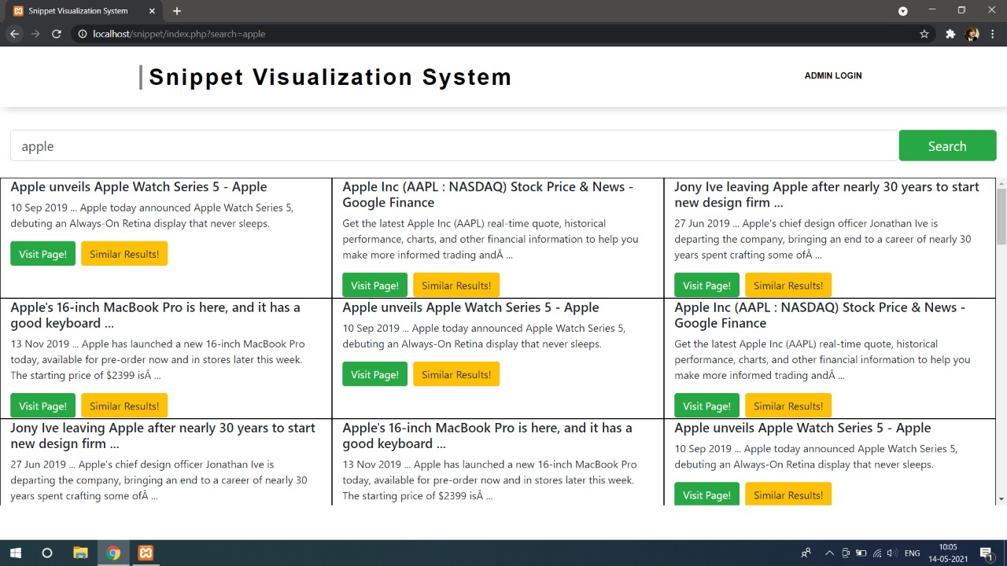

Slide 30
12. Conclusion:
We introduced Snippet visualization technique to visualize the collection of textual result returned from webpage. The system collect url from webpage displayed as a result of search query and store it on the database.
After storing the data on database it will display all collected text, url and description to the server side.
Then it starts preprocessing on collected url. Hence it is useful to the system to do further task. Finally preprocessed data as a output displayed.

Slide 31
13. Further Work:
After preprocessing has completed successfully system will form cluster of similar document using k-means algorithm.
After that system will rank data according to user’s hit ratio for particular site.
Then while displaying result it will optimize the placement of snippet so, that overlapping within snippet get removed.

Slide 32
14.References
1. Papers :
1. [1] “Similarity Preserving Snippet-Based Visualization of Web Search Results” Erick Gomez- Nieto, Frizzi San Roman, Paulo Pagliosa, Wallace Casaca, Elias S. Helou, Maria
2.Cristina F. de Oliveira, and Luis Gustavo Nonato, IEEE transactions on visualization and computer graphics, vol. 20, no. 3, MARCH 2014.
3. “Visualization on Web Snippets”: A Survey Shefali Kedia1, Prof. K. P. Wagh, Dr. P. N. Chatur International Journal of Innovative Research in Science, Engineering and Technology. Volume 6, Special Issue 1, January 2017.
2. Websites :
1. https://www.analyticsvidhya.com/blog/2014/11/text-data-cleaning-steps-python
2. https://ctrlq.org/code/20076-google-search-api
3. https://searchengineland.com/how-to-use-fetch-as-googlebot-like-seo-samurai-214292

Slide 33
3. Books :
1. The Joy of PHP Programming: A Beginner’s Guide – by Alan Forbes
2. PHP & MySQL Novice to Ninja – by Kevin Yank
3. Java the complete reference book by Herbert Schildt

Slide 34
Thank You…!!!!

